Slide 1
Sequential Logic
CSCI 2050U - Computer Architecture
Randy J. Fortier
@randy_fortier

Slide 2
Outline
Finite state machines
Oscillators
The clock
Storage:
Latches
Flip flops
Registers
Counters
Memory arrays

Slide 3
Finite State Machines
CSCI 2050U - Computer Architecture

Slide 4
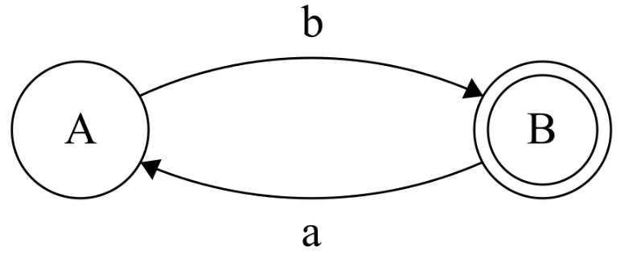
Finite State Machines (FSMs)
Also called finite state automata (singular: finite state automaton)
A model which as a finite number of states
Inputs may cause transitions between those states
They are used to model situations where we care about what happened before
This is a state machine that differentiates between strings that end with a and strings that end with b:
Drawn using http://madebyevan.com/fsm/
Notes:
Arrows indicate transitions between states. A state is shown as a circle. If the circle is doubled, it is an accept state. If the input ends in one of these states, the input is accepted; otherwise, it is rejected.

Slide 5
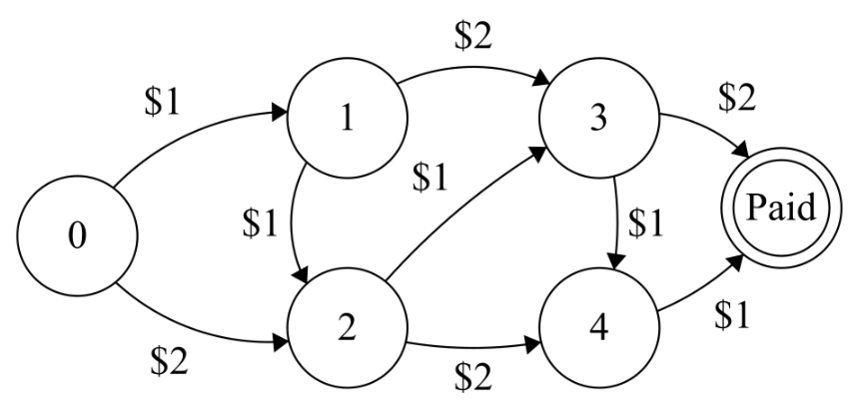
Finite State Machines (FSMs)
Let’s say that we want to create a device for our parking lot that will let our customers pay the flat rate of $5 using $1 or $2 coins:
Drawn using http://madebyevan.com/fsm/
Notes:
Every possible way of paying using $1 and $2 coins is represented.

Slide 6
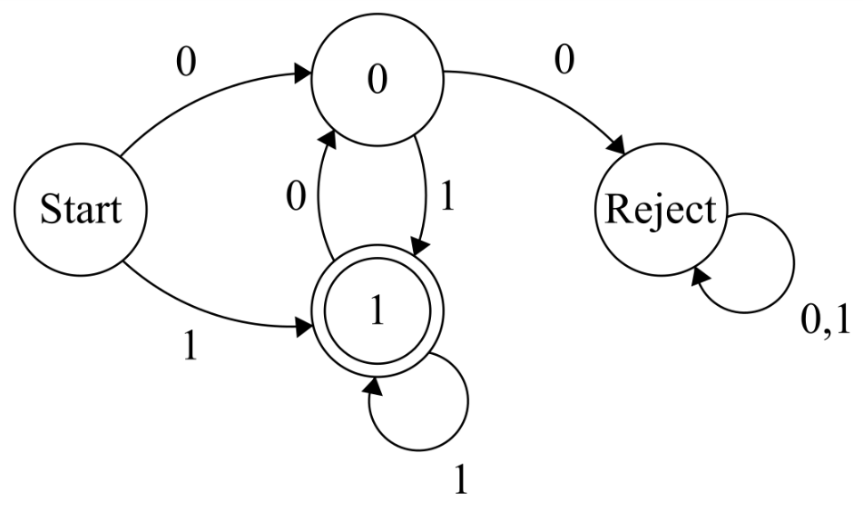
Finite State Machines (FSMs)
Let’s say that we want to create a device for recognizing a sequence of bits
The sequence must end in 1, but cannot have 00 anywhere
Note the self transitions in this state diagram
Drawn using http://madebyevan.com/fsm/
Notes:
This FSM is pretty random, but it does illustrate self-transitions.

Slide 7
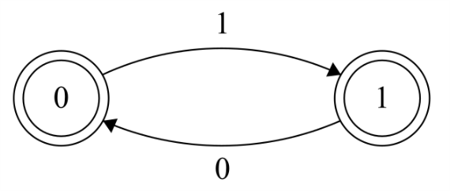
Finite State Machines (FSMs)
An FSM representing a 1-bit storage:
Drawn using http://madebyevan.com/fsm/
Notes:
It should be noted that this is a Moore (of Moore’s Law fame) FSM, as it arrows represent input values. This is in contrast to Mealy FSMs, which use transitions (before → after) for its arrows.

Slide 8
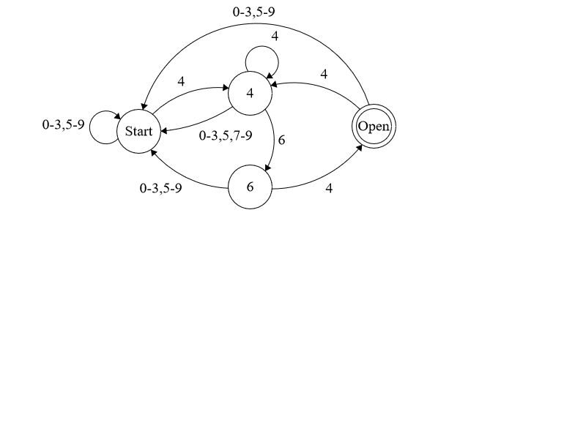
Finite State Machines (FSMs)
Let’s do an example
Let’s create an FSM to recognize our locker combination: 4 6 4
Here is the answer:
Drawn using http://madebyevan.com/fsm/

Slide 9
FSM → Circuit
Let’s try to convert this simple FSM into a circuit:
Drawn using http://madebyevan.com/fsm/

Slide 10
FSM → Circuit
What if we did this?
Does this work?
input | Q | Q’
0 | 0 | 0
0 | 1 | 0
1 | 0 | 1
1 | 1 | 1
Drawn using http://madebyevan.com/fsm/
Notes:
In this example, I’ve just drawn a truth table (combinational logic-style). Q is the current value, and Q’ is the new value.

Slide 11
FSM → Circuit
What if we did this?
Does this work?
It works once, but we need a continuing storage
Let’s forge ahead, anyway
input | Q | Q’
0 | 0 | 0
0 | 1 | 0
1 | 0 | 1
1 | 1 | 1
Notes:
This doesn’t work because it does only lets us set the value once, which does not match the FSM. Let’s draw the circuit and see what happens.

Slide 12
FSM → Circuit
Simplifying this circuit (e.g. with a K-map) will be left as an exercise
Q’ = input
Q’ input
input | Q | Q’
0 | 0 | 0
0 | 1 | 0
1 | 0 | 1
1 | 1 | 1

Slide 13
FSM → Circuit
This won’t work repeatedly
There are no logic gates to refresh the signal
Attenuation and noise will eventually destroy the signal
input Q’

Slide 14
FSM → Circuit
This is a bit better
The NOT gates will refresh the signal
With two NOT gates, the value will not change
The problem is that any change to input will change the value
If input always had the correct value, we would not need memory
What if input comes from an ALU circuit?
Q’
input
Notes:
Imagine we have a program that adds A, B, and C together. First, our adder circuit calculates A+B and puts the result into a register. Then, our adder circuit calculates that register + C and puts the result into a different register. The output from the adder circuit changed, but the register value should not have changed.

Slide 15
FSM → Circuit
The circuit below is our first sequential logic circuit
You can always identify a sequential logic circuit by the feedback (circular patterns) in the graph
Imagine the value continuously travelling around the circular path
How fast?
Q’
input
Notes:
Infinite? Speed of light? Slower?

Slide 16
FSM → Circuit
The circuit below is our first sequential logic circuit
You can always identify a sequential logic circuit by the cycles (circular patterns) in the graph
Imagine the value continuously travelling around the circular path
How fast?
The signal would be slower than the speed of light, due to the wire’s resistance
This is called the circuit’s propagation delay
Q’
input
Notes:
The resistance in the wire will slow down the travel time of electrons. The gates will slow things down even more. Still, it is too fast. It could be hard to time everything just right in a circuit that requests various things to happen sequentially in a circuit like this. We need a timing mechanism, so we can control it.

Slide 17
Oscillators and the Clock
CSCI 2050U - Computer Architecture

Slide 18
Oscillator
The circuit below is a bit surprising
It may seem like a logical contradiction
The input to the NOT gate is the same as its output, yet a NOT gate inverts its input
Remembering that every circuit has a propagation delay, though, it should become obvious that this circuit oscillates between 0 and 1:
C
Notes:
This circuit is a very basic oscillator. It generates a sequence of values: 0, 1, 0, 1, …
We can even control the speed of this oscillator, by adding more gates, extending the paths, etc.

Slide 19
The Clock
Modern computers use something like an oscillator to choreograph the operations of its circuits
The signal generated by the oscillator is called the clock signal
The oscillators used in moderns computers looks nothing like this
We expect to be able to tune the clock frequency to our needs
Factory clocking
Overclocking
C
Notes:
I won’t show what a real oscillator circuit looks like, as this is (thankfully) not an electrical engineering course.

Slide 20

The Clock
The purpose of the clock is to make sure everything happens at the right time
Load the first value into register A from memory
Load the second value into register B from memory
Add register A to register B, putting the result into register A
Store register A into memory
The clock signal is a predictable pattern, with regular timing
f = 1/t
Notes:
This is an idealized clock signal. V_{H} is the high voltage, usually representing 1. V_{L} is the low voltage, usually representing 0. The entire cycle of high + low is called a period, and is measure in time (typically nanoseconds). The frequency, given in this formula, is equivalent, and is measured in Hz (or GHz, billions of times per second). In other words, how many pulses per second?

Slide 21
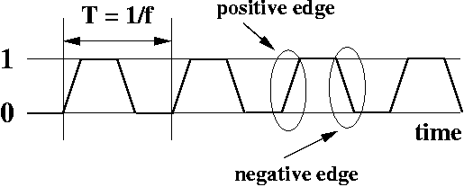
The Clock
The purpose of the clock is to make sure everything happens at the right time
Load the first value into register A from memory: Positive edge
Load the second value into register B from memory Negative edge
Add register A to register B, putting the result into register A Positive edge
Store register A into memory Negative edge
Notes:
This clock signal is a bit more realistic. Notice that the transition from low to high (and from high to low) is not instantaneous. We call these transitions, edges. The positive edge is when transitioning from V_{L} to V_{H}, and the negative edge is the transition from V_{H} to V_{L}.

Slide 22
Storage
CSCI 2050U - Computer Architecture

Slide 23
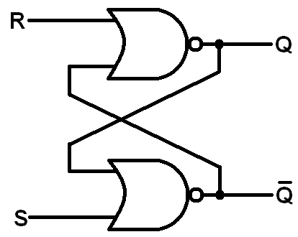
Latches
The sequential logic circuits, with feedback, that we’ve seen are used to create latches and flip flops
A latch is a 1-bit storage sequential circuit
Here is a common latch, called an S-R latch:
Notes:
The most basic unit of storage is a latch. A latch has no control over when it loads it value, but can store one bit of information.

Slide 24
Latches
The S-R latch will be a good introductory storage component
S: Set - when this input is 1, the value stored in the latch will become 1
R: Reset - when this input is 1, the value stored in the latch will become 0

Slide 25
Latches
Let’s examine every combination of input values:
Q_{i} | R | S | Q_{i+1} | Q_{i+1}’
0 | 0 | 0 | ? | ?
0 | 0 | 1
0 | 1 | 0
0 | 1 | 1
1 | 0 | 0
1 | 0 | 1
1 | 1 | 0
1 | 1 | 1
Notes:
These are NOR gates. As a reminder, a NOR gate only produces a 1 output when both of its inputs are 0.
The Q’ output is always the opposite of Q, so it has been excluded from this truth table (on the left side).

Slide 26
Latches
Let’s examine every combination of input values:
Q_{i} | R | S | Q_{i+1} | Q_{i+1}’
0 | 0 | 0 | 0 | 1
0 | 0 | 1 | ? | ?
0 | 1 | 0
0 | 1 | 1
1 | 0 | 0
1 | 0 | 1
1 | 1 | 0
1 | 1 | 1
Notes:
R=0, S=0: No change in the value of Q The value of Q is 0, so Q’ is 1, and R is 0, so the top NOR gate outputs a 0, making Q a 0 as well.
Similarly, Q being 0 and S being 0 means that the bottom NOR gate outputs a 1. Notice that Q and Q’ have not changed (stable).

Slide 27
Latches
Let’s examine every combination of input values:
Q_{i} | R | S | Q_{i+1} | Q_{i+1}’
0 | 0 | 0 | 0 | 1
0 | 0 | 1 | 1 | 0
0 | 1 | 0 | ? | ?
0 | 1 | 1
1 | 0 | 0
1 | 0 | 1
1 | 1 | 0
1 | 1 | 1
Notes:
R=0, S=1: Set the value of Q to 1 Q is 0, so Q’ is 1, and R is 0, so the top NOR gate outputs a 0, making Q a 1 (for now)
Q is 1 and S is 1 so the bottom NOR gate outputs a 0, making Q’ a 0.
Now, Q’ is a 0 ad R is 0, so the top NOR gate now outputs a 1, making Q a 1 (it is now stable)

Slide 28
Latches
Let’s examine every combination of input values:
Q_{i} | R | S | Q_{i+1} | Q_{i+1}’
0 | 0 | 0 | 0 | 1
0 | 0 | 1 | 1 | 0
0 | 1 | 0 | 0 | 1
0 | 1 | 1 | ? | ?
1 | 0 | 0
1 | 0 | 1
1 | 1 | 0
1 | 1 | 1
Notes:
R=1, S=0: Reset the value of Q to 0 Q is 0 and S is 0 so the bottom NOR gate outputs a 1, making Q’ a 1.
Q’ is 1, and R is 1, so the top NOR gate outputs a 0, making Q’ a 0.
Q’ is now 0, and R is 1, so the top NOR gate outputs a 0, keeping Q’ a 0.
(it is now stable)

Slide 29
Latches
Let’s examine every combination of input values:
Q_{i} | R | S | Q_{i+1} | Q_{i+1}’
0 | 0 | 0 | 0 | 1
0 | 0 | 1 | 1 | 0
0 | 1 | 0 | 0 | 1
0 | 1 | 1 | undef | undef
1 | 0 | 0 | ? | ?
1 | 0 | 1
1 | 1 | 0
1 | 1 | 1 | undef | undef
Notes:
R=1, S=1: Undefined This produces Q and Q’ both 0, which goes against our specification. This will be undefined behaviour.

Slide 30
Latches
Let’s examine every combination of input values:
Q_{i} | R | S | Q_{i+1} | Q_{i+1}’
0 | 0 | 0 | 0 | 1
0 | 0 | 1 | 1 | 0
0 | 1 | 0 | 0 | 1
0 | 1 | 1 | undef | undef
1 | 0 | 0 | 1 | 0
1 | 0 | 1 | ? | ?
1 | 1 | 0
1 | 1 | 1 | undef | undef
Notes:
R=0, S=0: No change in the value of Q Q is 1 and S is 0 so the bottom NOR gate outputs a 0, making Q’ a 0.
Q’ is 0, and R is 0, so the top NOR gate outputs a 1, making Q a 1.

Slide 31
Latches
Let’s examine every combination of input values:
Q_{i} | R | S | Q_{i+1} | Q_{i+1}’
0 | 0 | 0 | 0 | 1
0 | 0 | 1 | 1 | 0
0 | 1 | 0 | 0 | 1
0 | 1 | 1 | undef | undef
1 | 0 | 0 | 1 | 0
1 | 0 | 1 | 1 | 0
1 | 1 | 0 | ? | ?
1 | 1 | 1 | undef | undef
Notes:
R=0, S=1: Set the value of Q to 1 Q is 1 and S is 1 so the bottom NOR gate outputs a 0, making Q’ a 0.
Q’ is 0, and R is 0, so the top NOR gate outputs a 1, making Q a 1.

Slide 32
Latches
Let’s examine every combination of input values:
Q_{i} | R | S | Q_{i+1} | Q_{i+1}’
0 | 0 | 0 | 0 | 1
0 | 0 | 1 | 1 | 0
0 | 1 | 0 | 0 | 1
0 | 1 | 1 | undef | undef
1 | 0 | 0 | 1 | 0
1 | 0 | 1 | 1 | 0
1 | 1 | 0 | 0 | 1
1 | 1 | 1 | undef | undef
Notes:
R=1, S=0: Reset the value of Q to 0 Q is 0 and S is 0 so the bottom NOR gate outputs a 1, making Q’ a 1.
Q’ is 1, and R is 1, so the top NOR gate outputs a 0, making Q a 0.

Slide 33
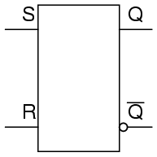
SR Latches
We can re-write this table more efficiently:
This is the block diagram representation of an SR latch:
R | S | Q_{i+1}
0 | 0 | Q_{i}
0 | 1 | 1
1 | 0 | 0
1 | 1 | undef
Notes:
While not a truth table, this state table is far more efficient.

Slide 34
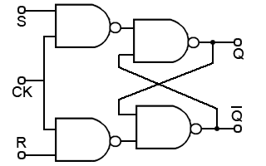
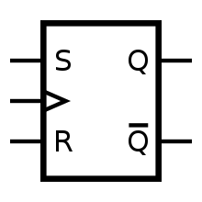
SR Flip Flops
The main issue with latches is that changes to the inputs start changing the value instantly
To control when values update, we use an SR flip flop
Flip flops are (clock) edge triggered
Notes:
The key difference here is that neither of the S or R inputs (to the latch) are set when the clock is not high. When the clock is low, therefore, the value of the latch does not change. The flip flop only allows values to change when the clock goes from V_{L} to V_{H}. This is called a positive edge triggered flip flop.

Slide 35
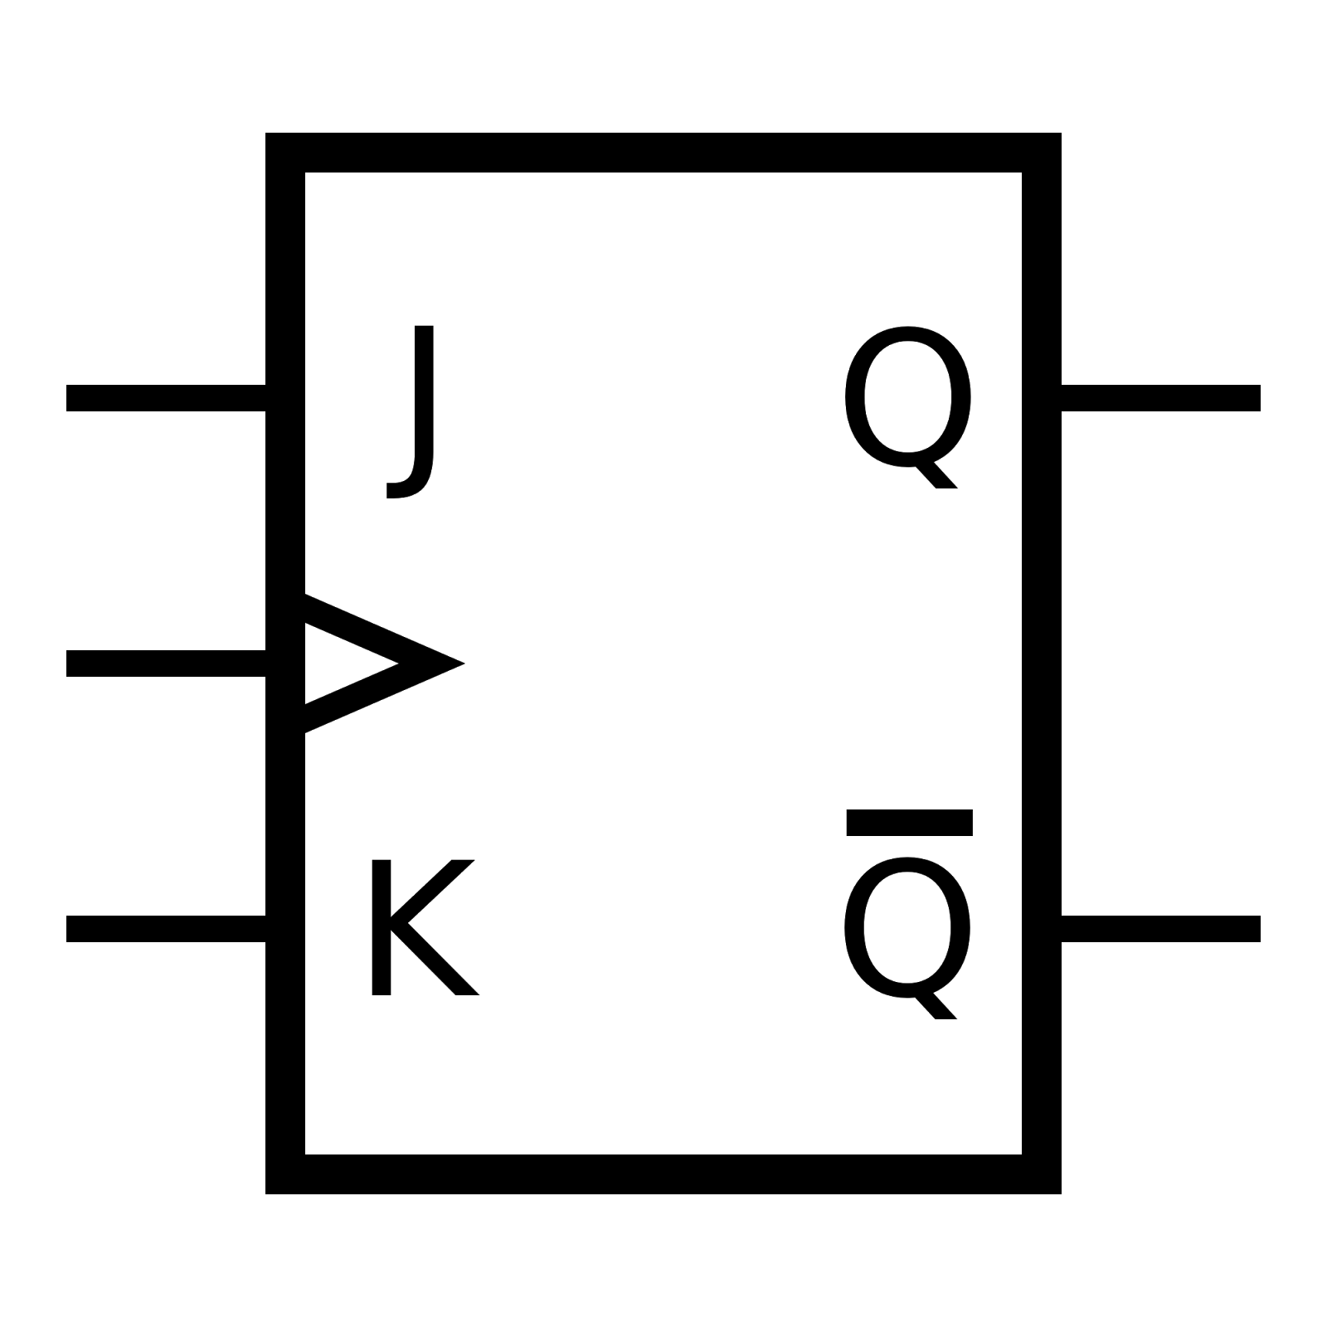
JK Flip Flops
A JK flip flop is identical to an SR flip flop, except:
It uses the S=1, R=1 input combination
S and R are called J and K, since they don’t strictly mean set and reset, anymore
When J = 1 and K = 1, the bit is flipped (0 → 1, 1 → 0)
J | K | Q_{i+1}
0 | 0 | Q_{i}
0 | 1 | 1
1 | 0 | 0
1 | 1 | Q_{i}’
Notes:
JK flip flops are the same, except that when J and K are both 1, the value in the flip flop is inverted.

Slide 36
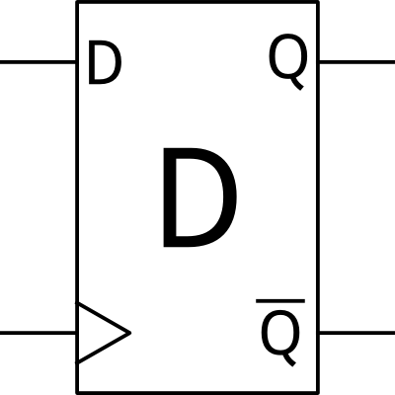
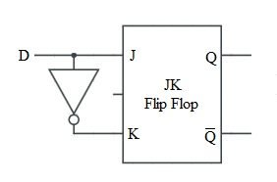
D Flip Flops
A D flip flop a much simpler concept:
It has one input, D
When D = 1, the value is set to 1
When D = 0, the value is set to 0
D | Q_{i+1}
0 | 0
1 | 1
Notes:
A D flip flop can easily be made from a JK flip-flop, as shown here. It doesn’t have the same fine-grained control. A D flip flop usually also has an enable input so that it doesn’t automatically write its value again every clock cycle.

Slide 37
Registers
CSCI 2050U - Computer Architecture

Slide 38
Registers
A register is a high-speed memory component accessible to the CPU
Special-purpose registers:
Program counter: Address of the next instruction to be executed
Memory address register: Address for memory storage/retrieval
Memory buffer register: Value to be stored to/the value retrieved from memory
Status register: A set of flags used for signalling (e.g. carry, overflow)
General-purpose registers:
Registers used as operands in arithmetic operations

Slide 39
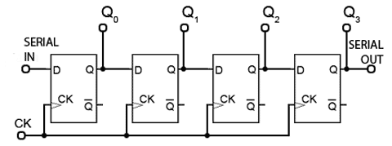
Registers
This is a 4-bit register with serial loading:
Clk

Slide 40
Registers
This is a 4-bit register with parallel loading:
In₀
D
Q
Out₀
In₁
D
Q
Out₁
In₂
D
Q
Out₂
In₃
D
Q
Out₃
Clk

Slide 41
Registers
This is the same 4-bit register shown in block notation:
In₀
D
Q
Out₀
4-bit register
In₁
D
Q
Out₁
In₂
D
Q
Out₂
In₃
D
Q
Out₃
Clk

Slide 42
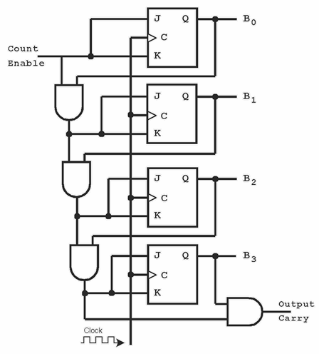
Registers
This is a 4-bit counter register:
Useful for the program counter and general-purpose registers

Slide 43
Memory
CSCI 2050U - Computer Architecture

Slide 44
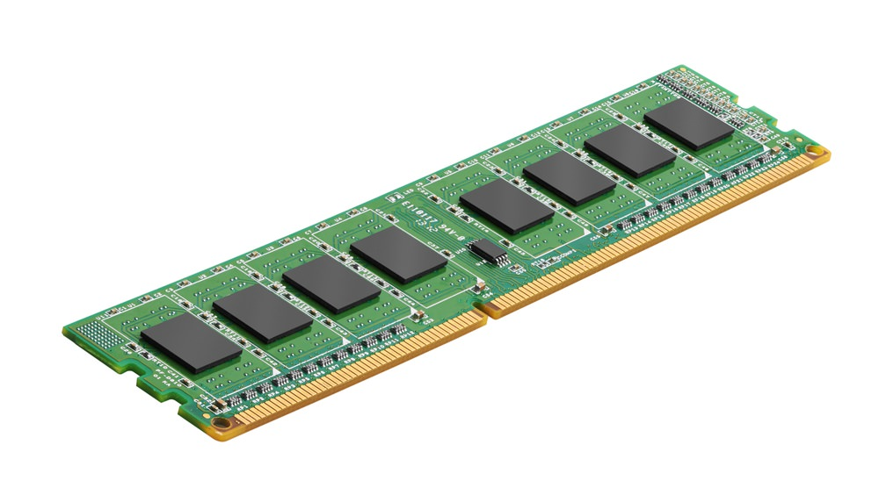
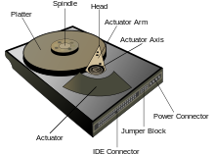
Memory
Memory is implemented in several different ways:
Magnetic - permanent, high-density, low-cost (HDD)
Flash - permanent, high-density, low-cost (SSD)
Capacitors - volatile, medium-density, medium-cost (DRAM)
Flip flops - volatile, low-density, high-cost (SRAM, cache)
Let’s look at how we can implement this type of memory
Other kinds of memory are discussed later:

Slide 45
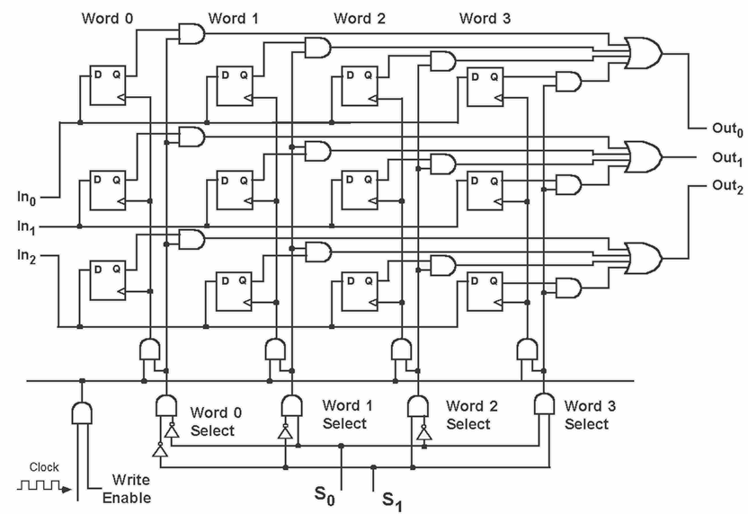
Memory Arrays
This is a 4x3-bit memory array
Notes:
This kind of memory, called SRAM or static RAM, is typically used in CPU caches. It can be expensive, and uses a lot of space on the processor die, but operates at the same clock speed as the CPU itself (i.e. it is fast).

Slide 46
Wrap-up
Finite state machines
Oscillators (clock)
Latches and flip flops
Registers
Memory
Notes:
In this section, we figured out how to implement a crucial component: storage
Note: Registers were one of our primary CPU components (along with the ALU and the Control Unit). We’ll discuss the control unit in the next section.

